Slide 1
Hotel Reservation Analysis with SQL

Slide 2
Overview:
We will work with a hotel reservation dataset to gain insights into guest preferences, booking trends, and other key factors that impact the hotel's operations. We will use SQL to query and analyze the data, as well as answer specific questions about the dataset.

Slide 3
Questions to answer:
What is the total number of reservations in the dataset?
Which meal plan is the most popular among guests?
What is the average price per room for reservations involving children?
How many reservations were made for the year 20XX (replace XX with the desired year)?
What is the most commonly booked room type?
How many reservations fall on a weekend (no_of_weekend_nights > 0)?
What is the highest and lowest lead time for reservations?
What is the most common market segment type for reservations?

Slide 4
Questions to answer:
How many reservations have a booking status of "Confirmed"?
What is the total number of adults and children across all reservations?
What is the average number of weekend nights for reservations involving children?
How many reservations were made in each month of the year?
What is the average number of nights (both weekend and weekday) spent by guests for each room type?
For reservations involving children, what is the most common room type, and what is the average price for that room type?
Find the market segment type that generates the highest average price per room.

Slide 5

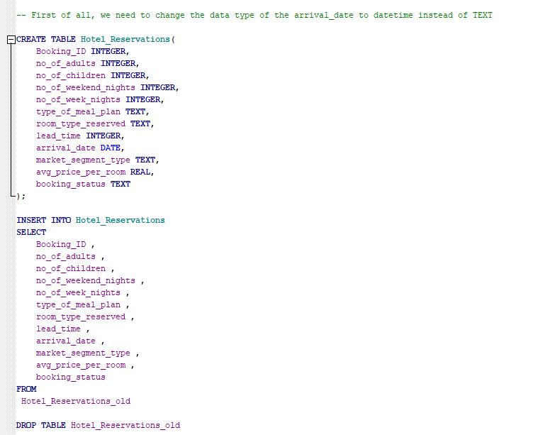
Changing the data type of the arrival date

Slide 6

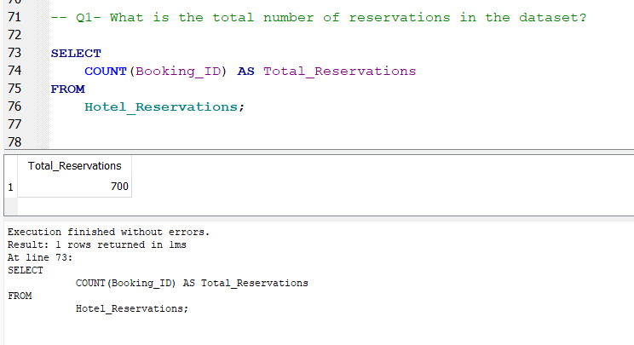
1- What is the total number of reservations in the dataset?
700

Slide 7
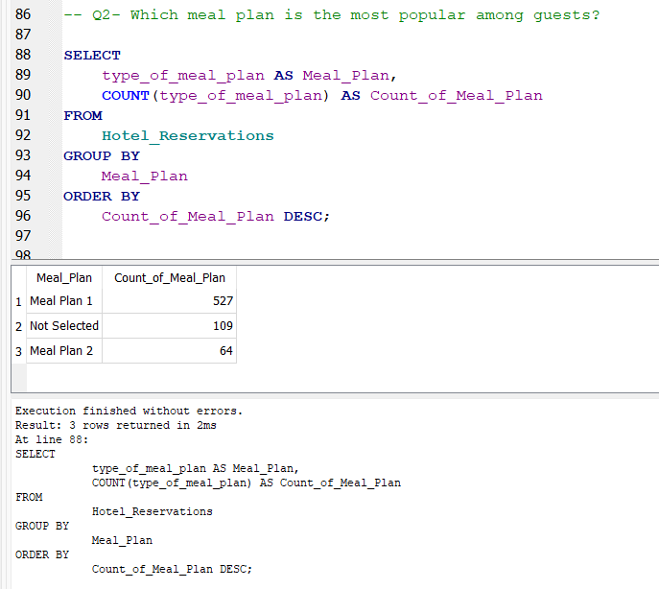
2- Which meal plan is the most popular among guests?
Meal Plan 1

Slide 8
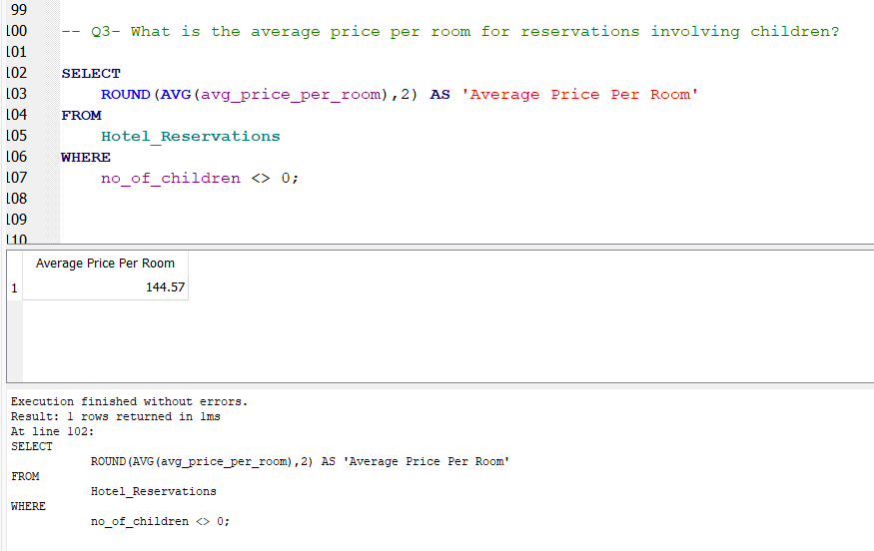
3- What is the average price per room for reservations involving children?
144.57

Slide 9
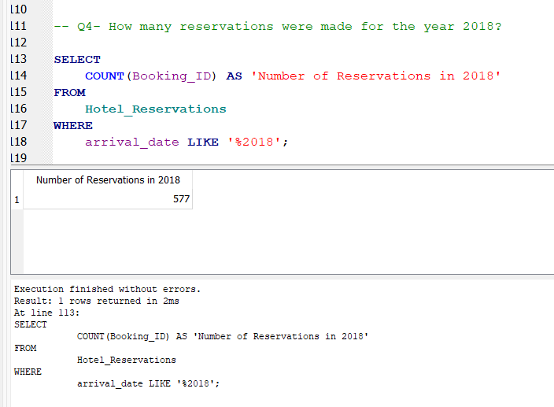
4- How many reservations were made for the year 2018?
577

Slide 10
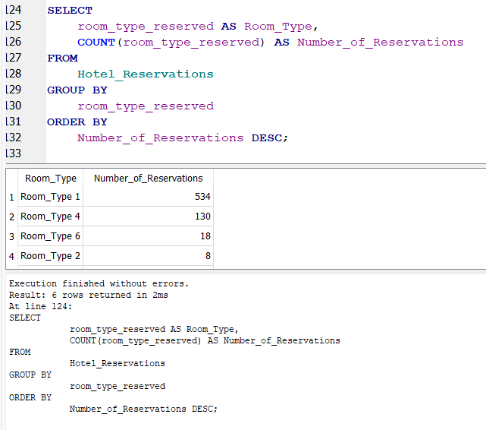
5- What is the most commonly booked room type?
Room_Type 1

Slide 11
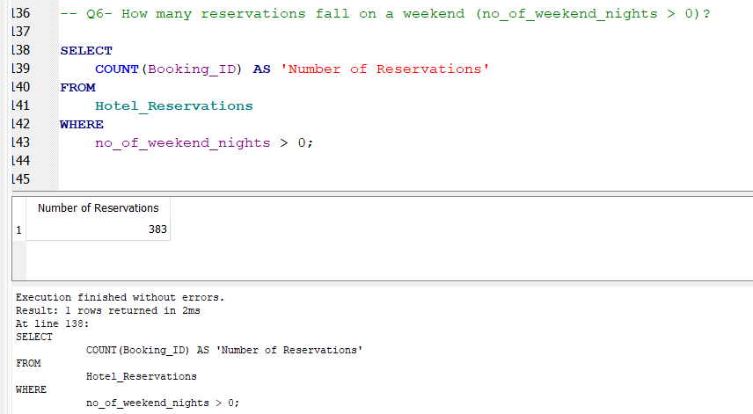
6- How many reservations fall on a weekend (no_of_weekend_nights > 0)?
383

Slide 12
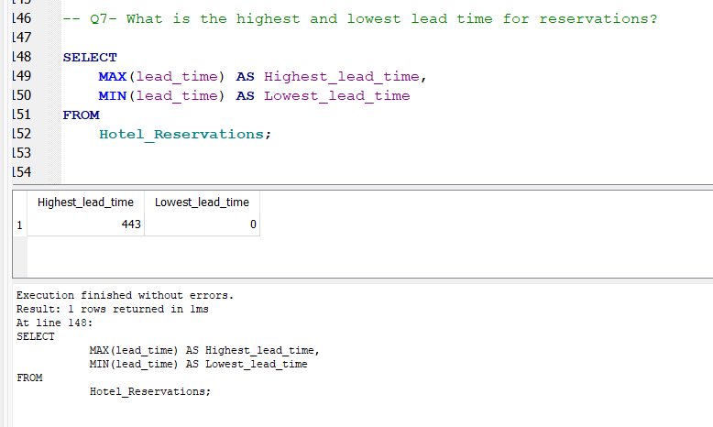
7- What is the highest and lowest lead time for reservations?
Highest lead time = 443
Lowest lead time = 0

Slide 13
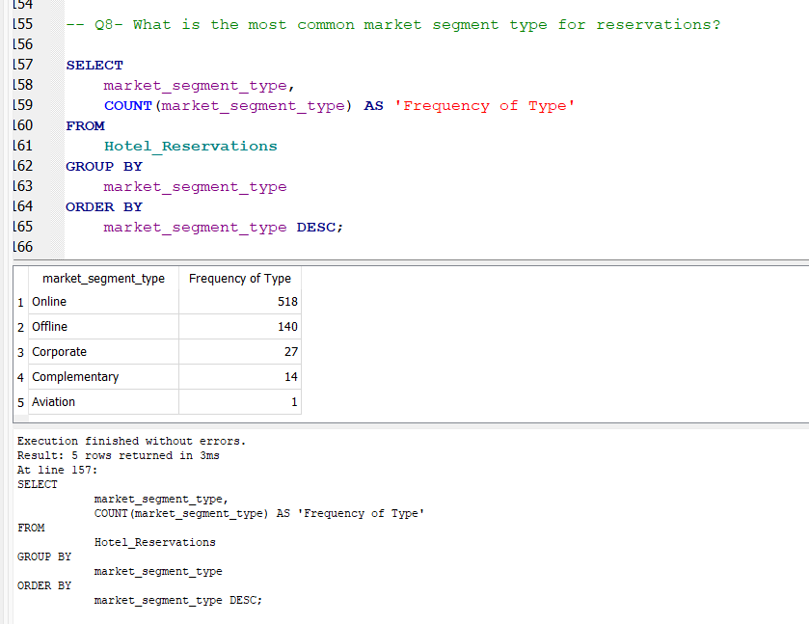
8- What is the most common market segment type for reservations?
Online

Slide 14
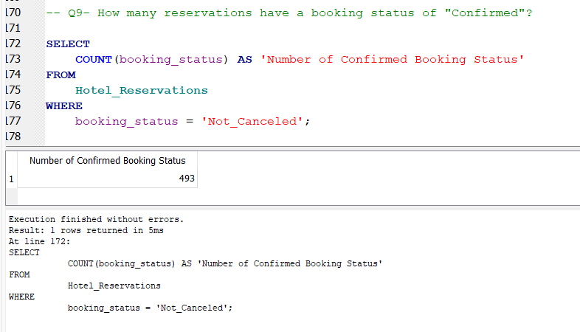
9- How many reservations have a booking status of "Confirmed"?
493

Slide 15
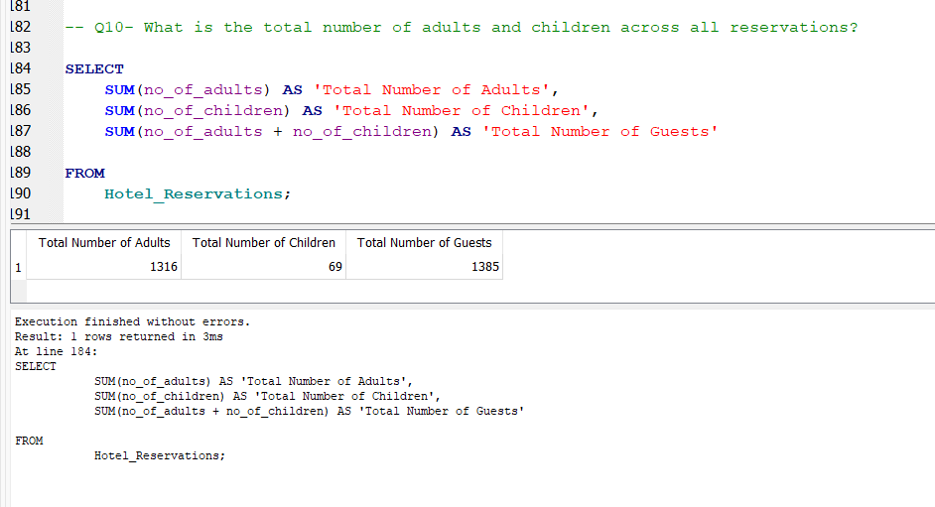
10- What is the total number of adults and children across all reservations?
1385

Slide 16
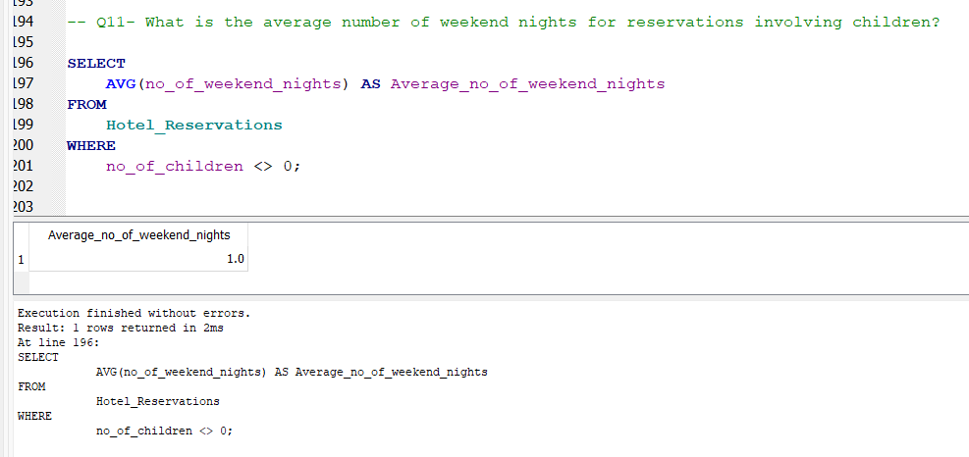
11- What is the average number of weekend nights for reservations involving children?
1.0

Slide 17
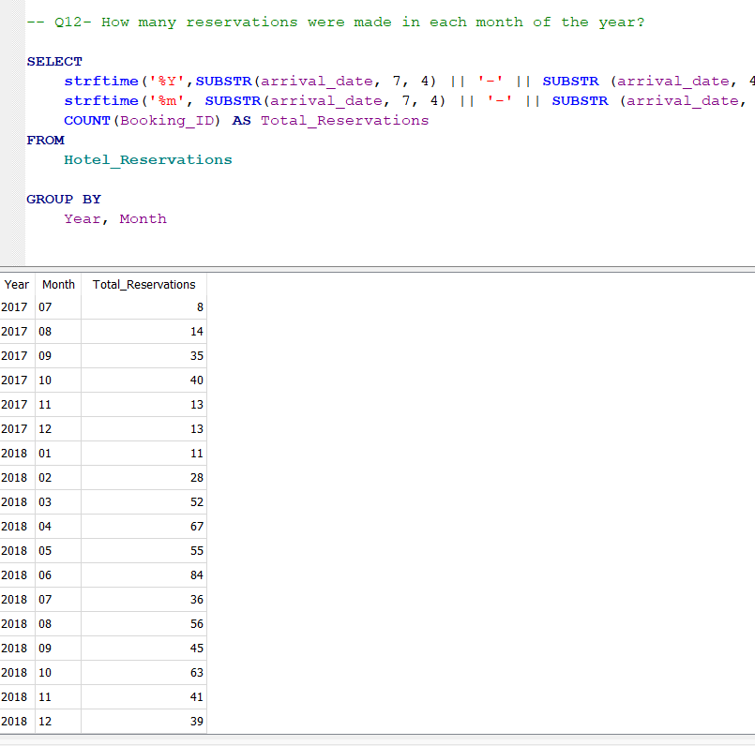
12- How many reservations were made in each month of the year?

Slide 18
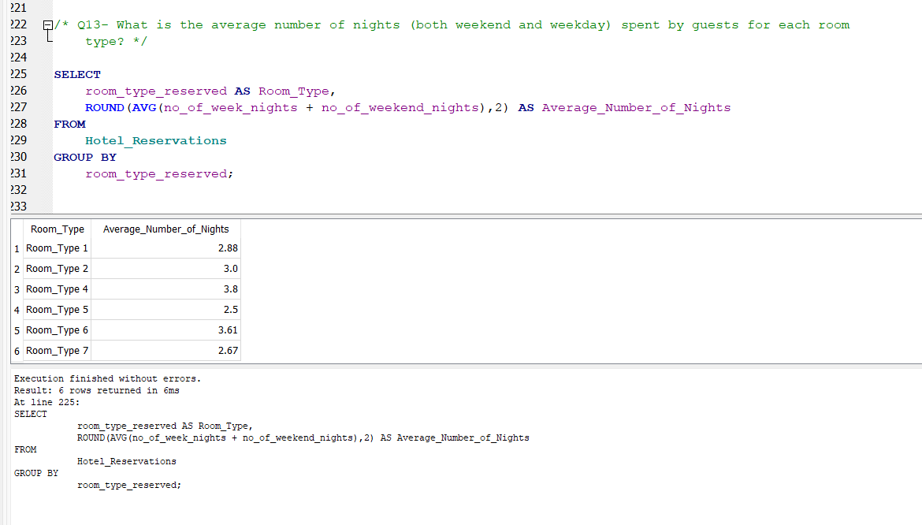
13- What is the average number of nights (both weekend and weekday) spent by guests for each room type?

Slide 19
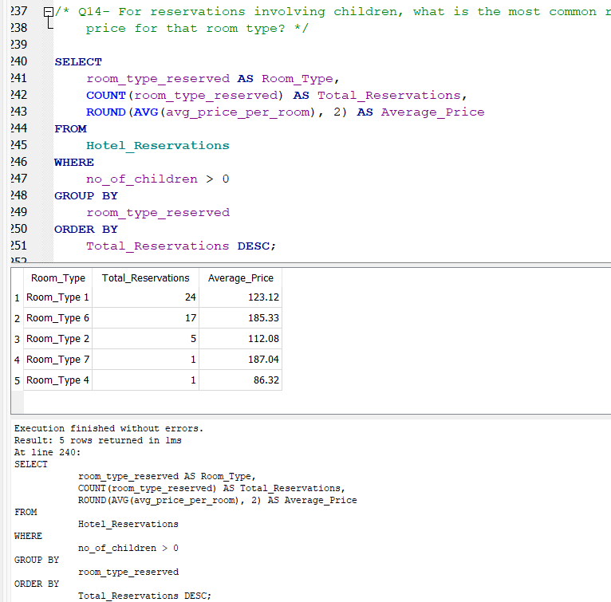
14- For reservations involving children, what is the most common room type, and what is the average price for that room type?

Slide 20
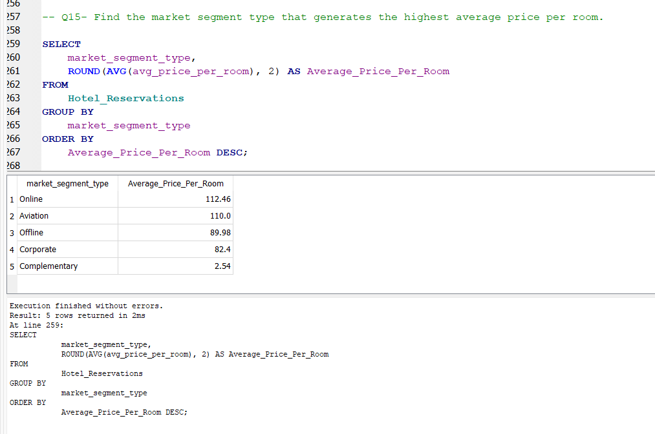
15- Find the market segment type that generates the highest average price per room.

Slide 21

Thank you

